Slide 1
Types of Expenses
Hafiz Rahim

Slide 2
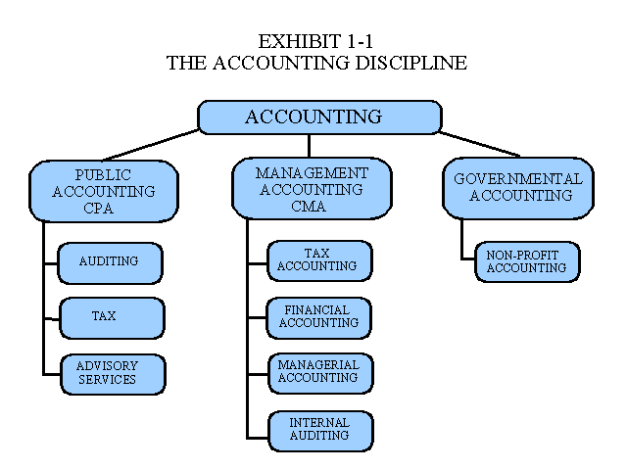
Durable goods
goods not for immediate consumption and able to be kept for a period of time.

Slide 3
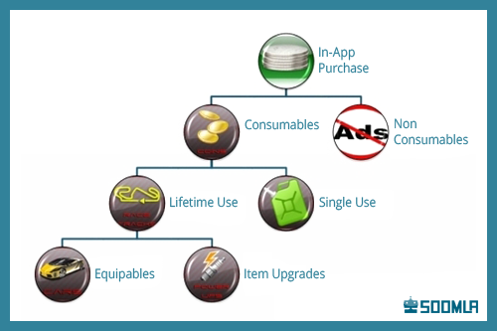
Consumable goods
Consumables (also known as consumable goods, nondurable goods, or soft goods) are goods that, according to the 1913 edition of Webster's Dictionary, are capable of being consumed; that may be destroyed, dissipated, wasted, or spent.

Slide 4
Fixed expenses
A fixed expense is an expense that will be the same total amount regardless of changes in the amount of sales, production, or some other activity. For example, a retailer's monthly rent expense of $2,000 is a fixed expense because it will be a total of $2,000 whether the monthly sales are $15,000 or $30,000.

Slide 5
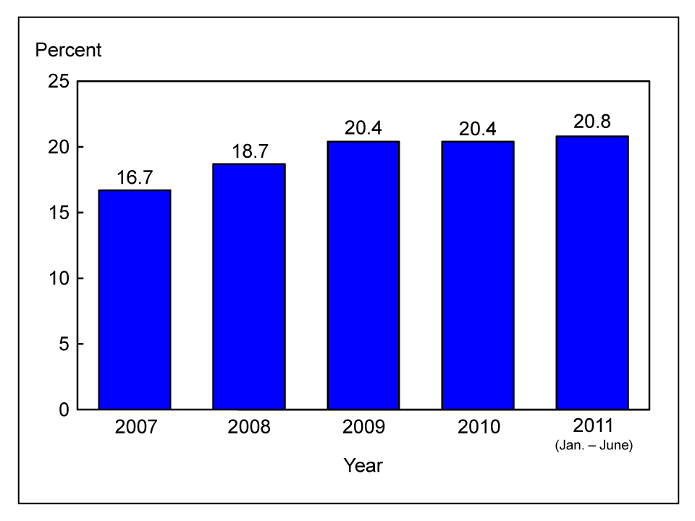
Variable or flexible expenses
In personal finance, flexible expense are costs that are easily changed, reduced or eliminated. Spending money on entertainment and clothing represent flexible expenses. Even expenses that must be incurred, such as a grocery bill, can be considered flexible because the amount spent can vary.

Slide 6
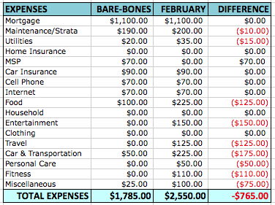
Discretionary expenses
A discretionary expense is a cost which is not essential for the operation of a home or a business. For example, a business may allow employees to charge certain meal and entertainment costs to the company in order to promote goodwill with employees

