Slide 1
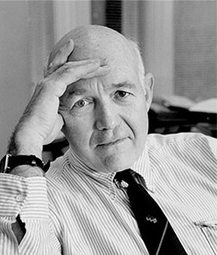
Born-Died
http://krieger.jhu.edu/sociology/wp-content/uploads/sites/28/2015/05/coleamn.jpg

Slide 2
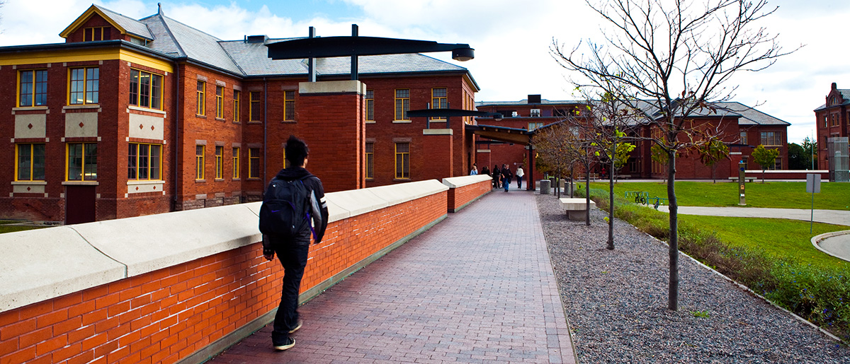
school
https://www.google.com/search?q=James+S.+Bell&safe=strict&espv=2&biw=1024&bih=667&source=lnms&tbm=isch&sa=X&ved=0CAgQ_AUoA2oVChMI1qzp69CIyQIVTOkmCh20igiy#safe=strict&tbm=isch&q=James+S.+Bell+school&imgrc=z_9Yaznd07B8-M%3A

Slide 3
grow up
https://www.google.com/search?q=James+S&safe=strict&es_sm=93&source=lnms&tbm=isch&sa=X&ved=0CAkQ_AUoA2oVChMIid2MjJGLyQIVCTsmCh1w3Q4L&biw=1024&bih=667#safe=strict&tbm=isch&q=Toronto&imgrc=XpNLU46GADCadM%3A

Slide 4
like as a person
https://www.google.com/search?q=wallpaper&safe=strict&biw=1280&bih=929&source=lnms&tbm=isch&sa=X&ved=0CAYQ_AUoAWoVChMI643T8MOXyQIVw-wmCh0OPQ-b#imgdii=iSv0nIVzjBp13M%3A%3BiSv0nIVzjBp13M%3A%3Bq1WHnMHgibBlmM%3A&imgrc=iSv0nIVzjBp13M%3A

Slide 5
https://www.google.com/search?q=James+S.+Bell&safe=strict&espv=2&biw=1024&bih=667&source=lnms&tbm=isch&sa=X&ved=0CAgQ_AUoA2oVChMI1qzp69CIyQIVTOkmCh20igiy#imgrc=_
https://www.google.com/search?q=James+S.+Bell&safe=strict&espv=2&biw=1024&bih=667&source=lnms&tbm=isch&sa=X&ved=0CAgQ_AUoA2oVChMI1qzp69CIyQIVTOkmCh20igiy#safe=strict&tbm=isch&q=James+S.+Bell+school&imgrc=z_9Yaznd07B8-M%3A
https://www.google.com/search?q=wallpaper&safe=strict&biw=1280&bih=929&source=lnms&tbm=isch&sa=X&ved=0CAYQ_AUoAWoVChMI643T8MOXyQIVw-wmCh0OPQ-b#imgdii=iSv0nIVzjBp13M%3A%3BiSv0nIVzjBp13M%3A%3Bq1WHnMHgibBlmM%3A&imgrc=iSv0nIVzjBp13M%3A

